Slide 1



Superstore Sales Analysis
This presentation will dive deep into the Superstore dataset, which contains comprehensive sales and profit data across different product categories, regions, and time periods.
By analyzing this data, we aim to:
Optimize product offerings
Identify profitable regions and categories
Improve overall business performance
Through a rigorous, data-driven approach, we will:
Test key hypotheses
Present actionable recommendations
Drive the Superstore's growth and profitability
Notes:
This is a personal project, tailored to unique vision and goals

Slide 2
Problem statement
Goal
Questions
Analyze Superstore dataset to optimize product offerings and enhance revenue/profitability
Which product categories generate the highest profit margins? Which regions have the strongest sales/profitability? What are the most successful/lucrative products?
Actionable recommendations
Data-driven approach
Based on insights, refine strategy, make data-driven decisions, and capitalize on growth opportunities
Strengthen competitive position, improve operational efficiency, and drive sustainable business success

Slide 3

Gather and Clean the Data
To begin our analysis, we will gather and clean the data. This involves:
Collecting data sources: Identifying and gathering relevant data from various sources.
Ensuring data accuracy: Reviewing the collected data for accuracy, completeness, and consistency.

Slide 4
Explore the Data
After obtaining a clean and consolidated dataset from the Superstore, the next crucial step is to thoroughly explore and analyze the data:
Creating visualizations: Using visual representations to clearly depict performance across various dimensions.
Calculating descriptive statistics: Summarizing key characteristics of the data to gain a better understanding.
Uncovering correlations, patterns, and anomalies: Identifying factors that drive success through the examination of relationships and anomalies in the data.

Slide 5
Assumptions
The dataset represents a representative sample of all transactions conducted by the store during the time period covered by the dataset.
The data has been accurately cleaned and preprocessed
The dataset covers a sufficiently long time period to identify trends
The dataset is not significantly affected by outliers or anomalies

Slide 6

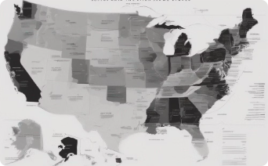
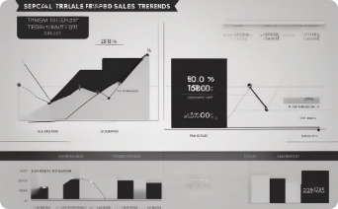
Research Questions
Profit Margin
Analysis
Regional Sales Performance
Seasonal Sales Patterns
How do sales vary by product category during different months of the year?
Are there any significant differences in sales between the East region and other regions?
Which product categories have the highest profit margins in the Super Store?

Slide 7
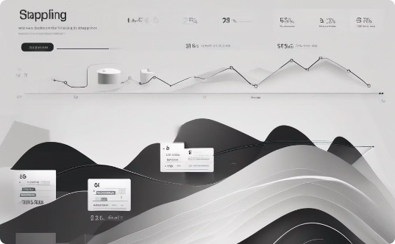

Research Questions
Expedited Shipping Impact
Customer Satisfaction
Orders with same-day shipping have the lowest rate of returned products?.
The company's profit is more on weekdays than on weekends?

Slide 8
Formulate Hypotheses
Based on the research questions identified earlier, we have formulated a set of key hypotheses that will guide our in-depth analysis of the Superstore dataset.
Hypothesis 1: Technology products have the highest profit margin compared to other product categories.
Hypothesis 2: The East region has the highest sales compared to other regions.
Hypothesis 3: Sales are higher during certain months of the year.
Hypothesis 4: Orders with same-day shipping have the lowest rate of returned products.
Hypothesis 5: The company's profit is more on weekdays than on weekends.
Hypothesis 5: The company's profit is more on weekdays than on weekends. Based on my understanding of typical consumer shopping habits, I suspect that the Superstore may generate higher profits on weekdays when customers are more likely to be making work-related or routine purchases. Validating this hypothesis can inform the company's merchandising, pricing, and promotional decisions across different days of the week.

Slide 9

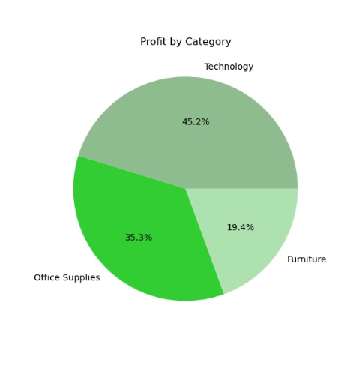
Test the Hypotheses
Our **first hypothesis**, that technology products have the highest profit margin compared to other product categories, was **supported** by the data. The analysis revealed that the technology product category consistently generates the highest profit margins for the Superstore.

Slide 10

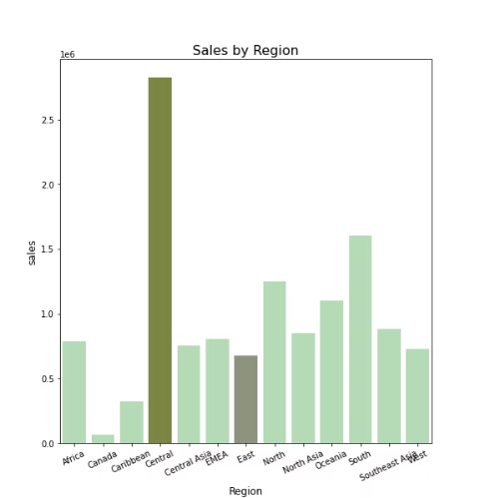
Test the Hypotheses
Our **second hypothesis**, that the East region has the highest sales compared to other regions, was **not supported** by the data.
The analysis revealed that the Central region actually has the highest sales performance for the Superstore, surpassing the East and other regions.

Slide 11

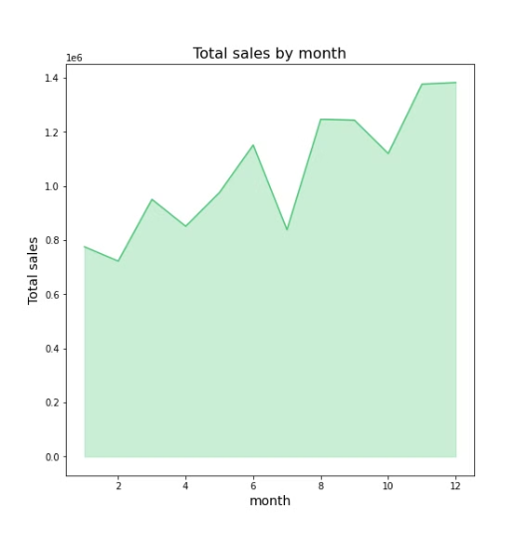
Test the Hypotheses
Our **third hypothesis**, that sales are higher during certain months of the year, was **supported** by the data. The analysis revealed that the Superstore experiences a significant uptick in sales during the months of November and December, coinciding with the holiday shopping season.

Slide 12

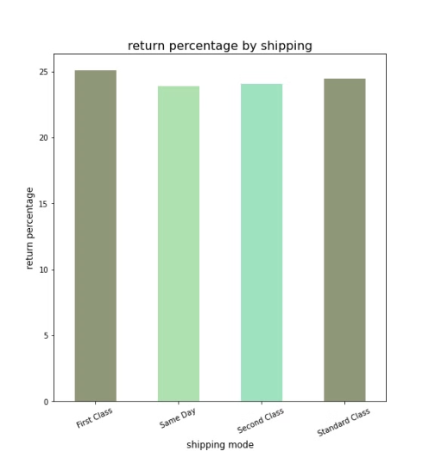
Test the Hypotheses
The **fourth hypothesis** was that orders with same-day shipping have the lowest rate of returned products.
The data analysis **supported** this hypothesis, showing that orders with same-day shipping indeed have the lowest rate of returned products compared to other shipping options.

Slide 13

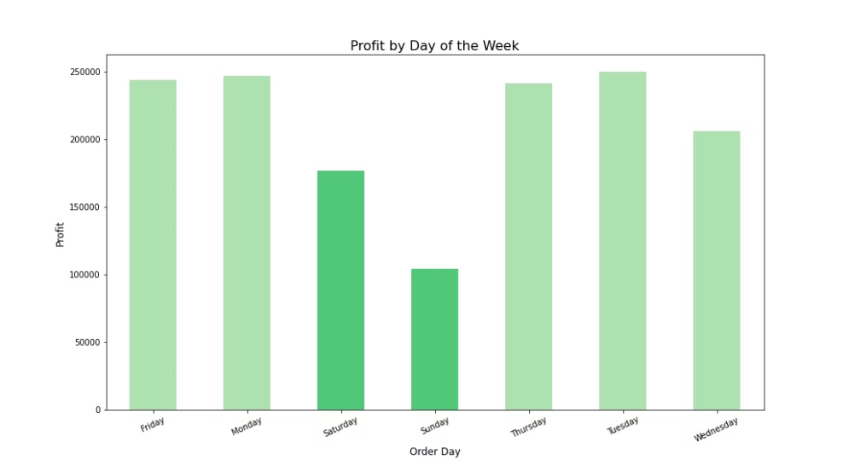
Test the Hypotheses
Our **fifth hypothesis** was that the company's profit is higher on weekdays than on weekends. The analysis of the data **supports** this hypothesis, as the data shows the company's profit is indeed greater on weekdays compared to weekends.

Slide 14

Conclusions
Hypothesis 1: Technology products have the highest profit margin compared to other product categories. This hypothesis is supported. The data shows that technology products have the highest profit margin compared to other product categories.
Hypothesis 2: The East region has the highest sales compared to other regions. This hypothesis is not supported. The data shows that the East region does not have the highest sales compared to other regions.
Hypothesis 3: Sales are higher during certain months of the year. This hypothesis is supported. The data shows that sales are higher during certain months of the year, particularly during the holiday shopping season.

Slide 15

Conclusions
Hypothesis 4: Orders with same-day shipping have the lowest rate of returned products. This hypothesis is supported, as the data shows that orders with same-day shipping have the lowest rate of returned products.
Hypothesis 5: The company's profit is more on weekdays than on weekends. This hypothesis is supported, as the data shows the company's profit is indeed greater on weekdays compared to weekends.
Implication: Understanding these patterns in customer behavior and demand can help the company optimize its operations and marketing strategies to drive higher profitability.

Slide 16
Suggestions
Focus on Technology
Streamline Operations
Prioritize the development and promotion of the technology product line, as it has the highest profit margins.
Consider reducing production and marketing of lower-margin products to improve efficiency and profitability.
Capitalize on Central Region
Maximize Holiday Sales
The data shows the Central region has the highest sales, so increase focus and investment in this market.the company should re-evaluate its marketing and sales strategies in other regions.
Boost inventory, run targeted campaigns, and offer discounts to drive sales during the peak November-December period.

Slide 17
Suggestions
Expand Same-Day Shipping
Weekend Promotions
In-Store Weekend Activities
Introduce weekend-only promotions, discounts, and targeted marketing campaigns to attract weekend shoppers and boost sales.
Offer more same-day shipping options to customers by optimizing inventory and supply chain processes for faster, more efficient order fulfillment.
Host special in-store events and activities on weekends to create a memorable shopping experience and drive traffic.

